Slide 1
Program Structure and Code Conventions
C# Coding Standards and Best Programming Practices
.Net Core. 2016

Slide 2
Introduction
The goal of this lecture is to provide a standard coding technique for C#. Net projects hold by the members of MS Solutions team.
The techniques defined here are not proposed to form an inflexible set of coding standards. They are rather meant to serve as a guide for developing a coding standard for a specific software project.

Slide 3
Agenda
General rules
File Organization
Namespaces.Classes. Interfaces.
Methods. Properties. Fields. Local Variables
Events and Delegates
Enum Naming Guidelines
Comments
Exception Handling
Format. Case study

Slide 4
General rules
1.1. General rules
“A name should tell ‘what’ rather then ‘how’.
Long enough to be meaningful - short enough to avoid verbosity.
Must be comprehensible by reader .
Avoid redundant class names while naming properties and methods
List.ListItem should be named List.Item
Fully usable from both case-sensitive and case-insensitive languages. Don’t use names that differ only by case.
Avoid using class names that duplicate .NET Framework namespaces: System, Collections, Forms, UI, etc.

Slide 5
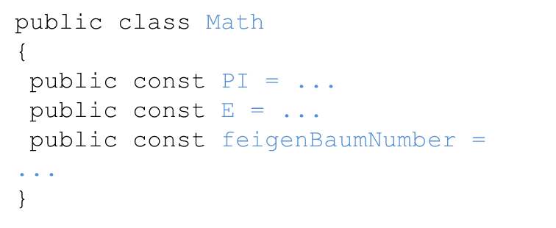
General rules
1.2. Capitalization Styles:
Pascal Casing - capitalize the first character of each word
TestCounter, Item, GroupName
Camel Casing - capitalize the first character of each word except the first one.
testCounter, name, firstName
Upper case - only use all upper case for identifier-abbreviation of 1 or 2 characters. Identifiers of more then 3 characters should use Pascal Casing instead.

Slide 6
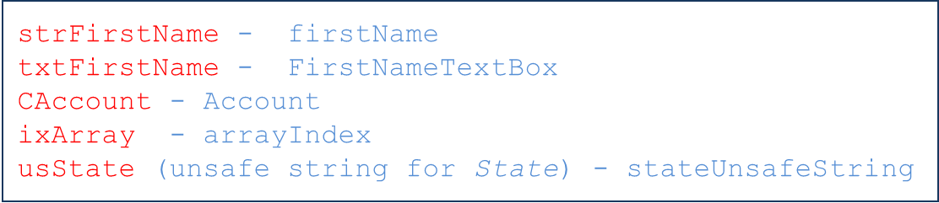
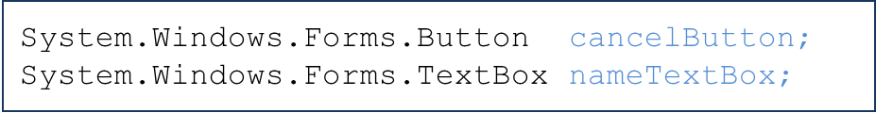
General rules
1.3. Hungarian notation
Is a defined set of pre and postfixes to names to reflect the type of the variable. Using Hungarian notation is not allowed.
An exception to this rule is GUI code:

Slide 7
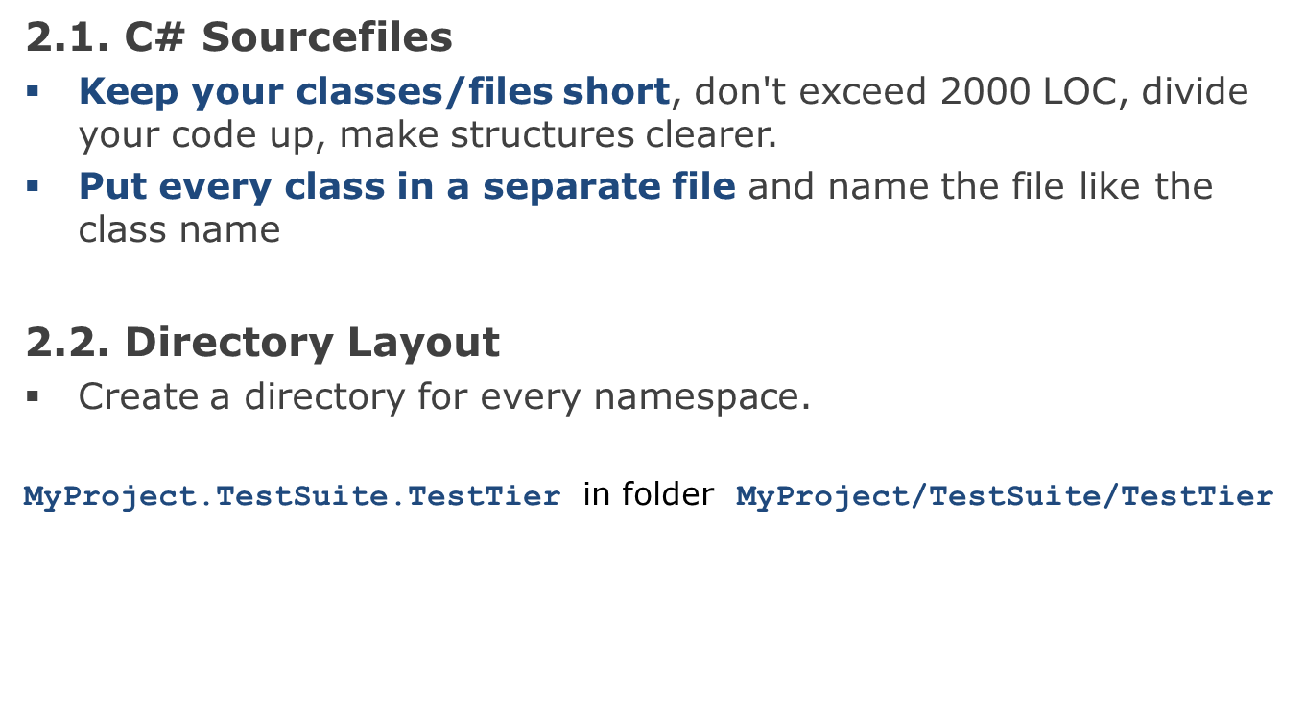
File Organization

Slide 8
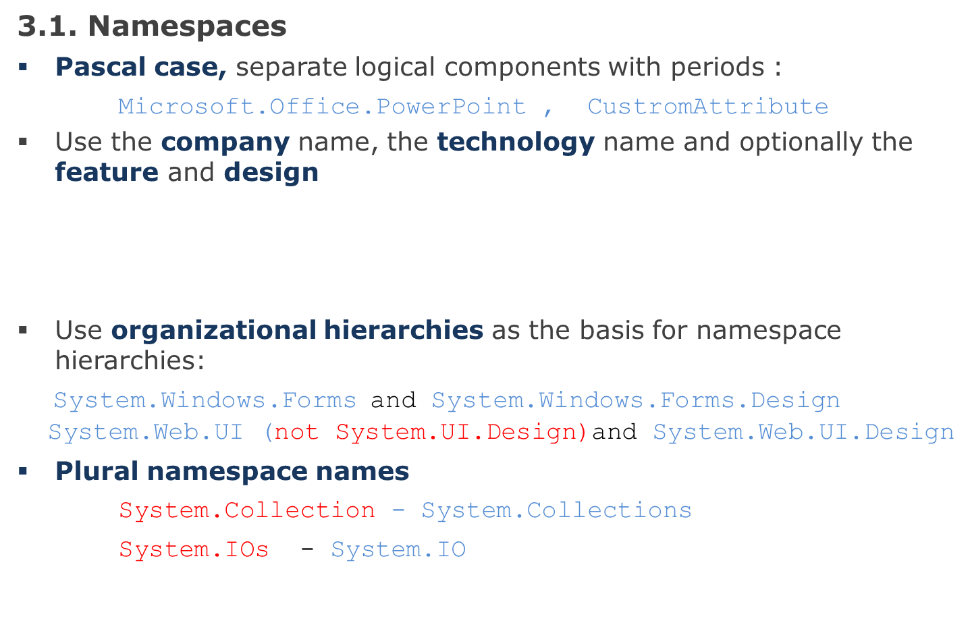
Namespaces
CompanyName.TechnologyName[.Feature][.Design]
Baseshop.Media
Baseshop.Media.Design

Slide 9
Classes names
3.2. Class
Class names must be nouns or noun phrases.
Use Pascal Casing
Do not use the same name for a namespace and a class
Do not use any class prefix
CFileStream _fileStream - FileStream

Slide 10
Interfaces names
3.3. Interfaces
Nouns, concatenated nouns or adjectives that describe behavior:
IComponent, ICustomAttributeProvider, IPersistable
Use I as prefix for the name
Use Pascal Casing

Slide 11
Methods names
3.4. Methods
Name methods with verbs or verb phrases
Use Pascal Casing for public and protected methods
Use Camel Casing for private methods:
public void CalculateTotal();
private int getAttribute()
Don’t use names with subjective interpretation:
OpenThis()
Method bodies - not more than 25 - 50 lines of code.
Use private functions to break down the business logic into sub-modules.

Slide 12
Methods. Best practices
Make the method name obvious
Good:
public void SavePhoneNumber ( string phoneNumber )
{
// Save the phone number.
}
Not good:
// This method will save the phone number.
void SaveData ( string phoneNumber )
{
// Save the phone number.
}

Slide 13
Methods. Best practices
A method should do only "one job".
Good:
// Save the address.
public void SaveAddress ( string address )
{
...
}
// Send an email to the supervisor to inform that the address is // updated.
public void SendEmail ( string email )
{
...
}
Not good:
// Save address and send an email to the supervisor
// to inform that the address is updated.
SaveAddress ( address, email );
void SaveAddress ( string address, string email )
{
// Job 1. Save the address.
// Job 2. Send an email to inform the supervisor
}

Slide 14
Fields names
3.5. Fields
Name fields with nouns, noun phrases or abbreviations for nouns
Use Camel Casing
Do not use public fields.
private int jobId;
Boolean fields (properties, variables, parameters) – have to start with prefix “is”, “has” or “does” :
boolean doesFileExist – fileExists
boolean isOpen - open

Slide 15
Properties names
3.6. Properties
Name properties using nouns or noun phrases
Use Pascal Casing
Name properties with the same name as appropriated field
private int jobId;
public int JobId {get;set;}
Write readonly property – for forbidding changes in the property's data by user.
Do not use write-only properties.

Slide 16
Local variables
3.7. Local variables and parameters
Use Camel casing
Even for short-lived local variables use a meaningful name.
Exceptions: ‘i’, ‘j’, ’k’, ’l’, ’m’, ’n’ - for loops variables;
‘x’, ‘y’, ‘z‘ - for coordinates;
‘r’, ‘g’, ‘b’ - for colors;
‘e’ - for event argument.
Avoid magic numbers: named constants in conditions instead of numbers (exceptions: 0, 1, –1):
for(i=0; i<NUM_DAYS_IN_WEEK; i++) instead of for(i=0; i<7; i++);

Slide 17
Local variables
Avoid using hard coded strings for messages that are displayed to user. Use a named constant, a database record or resource file item instead.
Use formatted strings instead building strings for custom messages :
MES_DELETE = "File {0} deleted.";
. . .
res = String.Format(MES_DELETE, drawFile.Name);

Slide 18
Enum
3.9. Enum
Use Pascal Casing for enum value names and enum type names
Don’t prefix (or suffix) enum type or enum values
Use singular names for enums
Use plural name for bit fields.
public enum StatusMode
{
Planned = 1,
Active = 2,
InActive = 4,
All = 7
};

Slide 19
Enum
Use enum instead using numbers or strings to indicate discrete values.
Not good:
Good:
enum MailType{ Html,PlainText,Attachment}
public void SendMail ( string message, MailType mailType )
{
switch ( mailType )
{
case MailType.Html:
// Do something
break;
case MailType.PlainText:
// Do something
break;
case MailType.Attachment:
// Do something
break;
default:
// Do something
break;
}
}
void SendMail (string message, string mailType)
{
switch ( mailType )
{
case "Html":
// Do something
break;
case "PlainText":
// Do something
break;
case "Attachment":
// Do something
break;
default:
// Do something
break;
}
}

Slide 20
Comments
4.1. Single Line Comments
Use complete sentences when writing comments.
Comments should be quite informative and understandable by other people
Always keeps the commenting up to date (actual).
Avoid adding comments at the end of a line of code (except local variable declarations)
Use comments on important loops and logic branches.
Comment all private field declarations (// ).
Block comments should usually be avoided.
/* Line 1
* Line 2
* Line 3
*/
int level; // indentation level
int size; // size of table

Slide 21
Comments
4.2. XML Documentation
In the .net framework is a documentation generation system based on XML comments.
At the beginning of every construction part of code (class, method, property, function or protected field declaration, etc.) use “<summary>” XML commenting tag (type “///” for automatically generation)
Provide descriptions of parameters and return value of methods and functions in the corresponding tags.
Documentation can be generated using the 'documentation' item in the #develop 'build' menu. The documentation generated is in HTMLHelp format.
/// <summary>
/// Checks that stored procedure exists in the database
/// </summary>
/// <param name="stProcName">Name of the stored procedure</param>
/// <returns>true if the procedure exists</returns>
public bool CheckSPExists( string stProcName )
{
. . .
}

Slide 22
Format
Establish and use a standard size for an indent through the project.
Default indent - tab size (4 space characters).
Line of code - less than 80 characters
Align open and close braces vertically :
for (i = 0; i < NUM_OBJECTS; i++)
{
. . .
}
Indent code along lines of logical construction:
if (reportId != BaseTable.INVALID_PK)
{
try
{
recReport = RepManager.GetRecordByPK(reportId);
}
catch (Exception ex)
{
HandleException(ex);
}
}
else
{
recReport = new RecReports();
}
for (…) {
. . .
}

Slide 23
Format
Break long statement it to several lines and use double indenting in next lines.
if (Member.Address.Room != null && Member.Address.Room != "" &&
(Member.Address.Sect > 0 || Member.Address.BuildNo > 0))
Member.Address.Normalize();
Break long statement with logical code structure.
Wrong formatting:
if (Address.Room != null && Address.Room != "" && (Address.Sect
> 0 || ((Address.BuildNo != null && Address.BuildNo !=
"")?Address.BuildNo:DEFAULT_BUILDING_NO) > 0) &&
Address.IsNotPrepared)
Member.Address.Normalize();

Slide 24
Format
Correct
if (Address.Room != null && Address.Room != "" &&
(Address.Sect > 0 ||
((Address.BuildNo != null && Address.BuildNo != "")?
Address.BuildNo:DEFAULT_BUILDING_NO) > 0) &&
Address.IsNotPrepared)
Member.Address.Normalize();
Good
if ( ... )
{
// Do something
. . .
}
Not good
if ( ... ) {
// Do something
. . .
}

Slide 25
Format
Use a single space before and after each operator and brackets.
Good:
if ( showResult == true )
{
for ( int i = 0; i < 10; i++ )
{
// . . .
}
}
Not good:
if(showResult==true)
{
for(int i= 0;i<10;i++)
{
// . . .
}
}

Slide 26


